Slide 1
Determinants of city quality-of-life perception: the interaction between city and life satisfaction
XV April International Academic Conference on Economic and Social Development
Dmitriy Potapov, HSE-Perm
Anastasiya Bozhya-Volya, HSE-Perm
Irina Shafranskaya, HSE-Perm
12th of May, 2014.
Higher School of Economics , 2014
www.hse.ru

Slide 2
Motivation and Purpose
In knowledge economy human capital become the main asset of the regions and cities
People choose place for living, they decide to stay or to leave (migration flows in the city of Perm increased twice from 2008 till 2011).
People with high human capital are more likely to change place for living
Local authorities can influence people choice throw urban services (satisfaction of public needs)
photo
The purpose of the paper is to measure how citizens satisfaction over different urban services (education, healthcare, safety, etc.) influence overall city satisfaction taking into account personal life satisfaction and happiness.
photo
Higher School of Economics - Perm
HSE, 2014

Slide 3
Theoretical Background
Subjective vs objective city quality-of-life approach (Tesfazghi, 2010: Obulicz – Kozaryn, 2013)
City quality-of-life could be considered as the individual’s subjective experience of dealing with different urban services (Diener and Suh, 1997; Kahneman and Kruger, 2006)
Subjective measures of city and life satisfaction inter-correlate (Cummins, 2000)
All this raises the task of separation of residents’ overall satisfaction with the city, urban services quality and personal happiness perception (Jeffres and Dobos, 1995)
photo
photo
Higher School of Economics - Perm
HSE, 2014

Slide 4
1. Linear Regression Model
photo
Look for the effect of different public needs satisfaction (urban services) on the overall city satisfaction
From M1 to M4 include control variables to «purify» the effects
Measure only direct effects
photo
Higher School of Economics - Perm
HSE, 2014

Slide 5
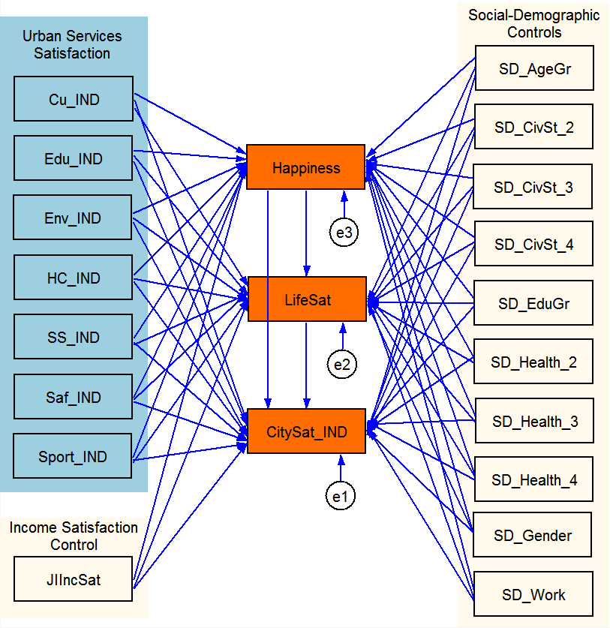
2. Path Analysis Model
Measure direct and indirect effects
photo
photo
XV April International Academic Conference
HSE, 2014

Slide 6
Data Collection
Door-to-door poll of more than 2000 inhabitants of Perm city (Russia). City population is around 1 million people.
Sample is representative over
Gender
Age
City districts (7 areas)
Questionnaire contained 35 composite questions covering satisfaction and attitude to different aspects of life in the city (i.e. education, safety, etc.) and overall city satisfaction, happiness and well-being.
Survey (sponsored by local authorities) was conducted in August-September, 2012
photo
photo
Higher School of Economics - Perm
HSE, 2014

Slide 7
Data Preparation
Drop out observations with many (more than 2/3 in parcel) missings (controlled for systematic bias)
Implemented parcel approach (Coffman, MacCallum, 2005) to convert different measures of a construct into one index
Imputed missings in parcels as a prediction on the basis of linear regression, where dependent variables include other questions from the same parcel and social-demographic variables
Generating parcel scores (indexes) as weighted sum of variables with equal weights
photo
photo
Higher School of Economics - Perm
HSE, 2014

Slide 8
Data Description - 1
Variable | Description | # of indicators | Type, Scale | # obs | Mean | S.d. | Min | Max
Personal happiness/satisfaction
CitySat_IND | City satisfaction | 5 | Likert (1…7) | 1781 | 5.1 | 1.4 | 1.0 | 7.0
LifeSat | Life satisfaction | 1 | Likert (1…7) | 1743 | 3.9 | 1.3 | 1.0 | 7.0
Happiness | Happiness | 1 | Likert (1…7) | 1774 | 5.6 | 1.5 | 1.0 | 7.0
JIIncSat | Income satisfaction | 1 | Likert (1…7) | 1754 | 3.6 | 1.5 | 1.0 | 7.0
Urban services satisfaction indexes
Cu_IND | Culture satisfaction index | 7 | Likert (1…7) | 1781 | 5.0 | 1.1 | 1.0 | 7.0
Edu_IND | Education satisfaction index | 11 | Likert (1…7) | 1781 | 4.3 | 1.0 | 1.0 | 7.0
Env_IND | Environment satisfaction index | 7 | Likert (1…7) | 1781 | 3.6 | 1.0 | 1.0 | 6.9
HC_IND | Health care satisfaction index | 5 | Likert (1…7) | 1781 | 3.5 | 1.2 | 0.9 | 7.0
SS_IND | Social security satisfaction index | 6 | Likert (1…7) | 1781 | 3.5 | 0.9 | 1.0 | 6.5
Saf_IND | Safety satisfaction index | 6 | Likert (1…7) | 1781 | 4.0 | 1.1 | 1.0 | 7.0
Sport_IND | Sport satisfaction index | 6 | Likert (1…7) | 1781 | 3.4 | 1.1 | 0.8 | 5.8
photo
photo
Higher School of Economics - Perm
HSE, 2014

Slide 9
Data Description - 2
Variable | Description | # of indicators | Type, Scale | # obs | Mean | S.d. | Min | Max
Social-demographic characteristics
SD_AgeGr | Age group | - | Ordered (6 groups) | 1781 | 3.7 | 1.3 | 1.0 | 6.0
SD_AgeGr_1 | 14-17 years | - | Dummy | 1781 | 0.1 | 0.2 | 0.0 | 1.0
SD_AgeGr_2 | 18-21 years | - | Dummy | 1781 | 0.1 | 0.3 | 0.0 | 1.0
SD_AgeGr_3 | 22-35 years | - | Dummy | 1781 | 0.3 | 0.5 | 0.0 | 1.0
SD_AgeGr_4 | 36-49 years | - | Dummy | 1781 | 0.3 | 0.4 | 0.0 | 1.0
SD_AgeGr_5 | 50-65 years | - | Dummy | 1781 | 0.2 | 0.4 | 0.0 | 1.0
SD_AgeGr_6 | 65+ years | - | Dummy | 1781 | 0.1 | 0.3 | 0.0 | 1.0
SD_CivSt | Civil status | - | Categorical (4 groups) | 1738 | 1.9 | 1.0 | 1.0 | 4.0
SD_CivSt_1 | Married | - | Dummy | 1738 | 0.5 | 0.5 | 0.0 | 1.0
SD_CivSt_2 | Not married | - | Dummy | 1738 | 0.3 | 0.5 | 0.0 | 1.0
SD_CivSt_3 | Widowed/Divorced | - | Dummy | 1738 | 0.2 | 0.4 | 0.0 | 1.0
SD_CivSt_4 | With partner | - | Dummy | 1738 | 0.1 | 0.3 | 0.0 | 1.0
photo
photo
Higher School of Economics - Perm
HSE, 2014

Slide 10
Data Description - 3
Variable | Description | # of indicators | Type, Scale | # obs | Mean | S.d. | Min | Max
Social-demographic characteristics
SD_EduGr | Education group | - | Ordered (5 groups) | 1765 | 3.3 | 1.3 | 1.0 | 5.0
SD_EduGr_1 | Incomplete second. edu | - | Dummy | 1765 | 0.1 | 0.3 | 0.0 | 1.0
SD_EduGr_2 | Second. edu | - | Dummy | 1765 | 0.2 | 0.4 | 0.0 | 1.0
SD_EduGr_3 | Second. prof. edu | - | Dummy | 1765 | 0.3 | 0.5 | 0.0 | 1.0
SD_EduGr_4 | Incomplete higher edu | - | Dummy | 1765 | 0.1 | 0.3 | 0.0 | 1.0
SD_EduGr_5 | Higher edu | - | Dummy | 1765 | 0.3 | 0.4 | 0.0 | 1.0
SD_Health | Health group | - | Ordered (4 groups) | 1751 | 1.7 | 0.9 | 1.0 | 4.0
SD_Health_1 | No restrictions | - | Dummy | 1751 | 0.5 | 0.5 | 0.0 | 1.0
SD_Health_2 | Few restrictions | - | Dummy | 1751 | 0.3 | 0.4 | 0.0 | 1.0
SD_Health_3 | Signif. restrictions | - | Dummy | 1751 | 0.1 | 0.3 | 0.0 | 1.0
SD_Health_4 | Strong restrictions | - | Dummy | 1751 | 0.1 | 0.2 | 0.0 | 1.0
SD_Gender | Gender | - | Dummy | 1781 | 0.5 | 0.5 | 0.0 | 1.0
SD_Work | Working status | - | Dummy | 1781 | 0.6 | 0.5 | 0.0 | 1.0
photo
photo
Higher School of Economics - Perm
HSE, 2014

Slide 11
Linear Regression Models – OLS Estimation
(we report B - standardized β)
Factors | Model1 | Model2 | Model3 | Model4
Personal happiness/satisfaction
LifeSat |  | 0.12*** | 0.02 | 0.05
 |  | (0.03) | (0.03) | (0.03)
Happ |  |  | 0.24*** | 0.27***
 |  |  | (0.02) | (0.02)
JIIncSat |  |  |  | 0.05**
 |  |  |  | (0.03)
Urban services satisfaction indexes
Cu_IND | 0.17*** | 0.17*** | 0.13*** | 0.10***
 | (0.04) | (0.04) | (0.03) | (0.03)
Edu_IND | 0.16*** | 0.15*** | 0.14*** | 0.11***
 | (0.04) | (0.04) | (0.04) | (0.04)
Env_IND | -0.02 | -0.02 | 0.01 | 0.00
 | (0.04) | (0.04) | (0.04) | (0.04)
HC_IND | 0.13*** | 0.10*** | 0.08** | 0.10***
 | (0.04) | (0.04) | (0.03) | (0.03)
SS_IND | -0.04 | -0.07 | -0.03 | -0.02
 | (0.05) | (0.05) | (0.04) | (0.04)
Saf_IND | 0.22*** | 0.21*** | 0.20*** | 0.16***
 | (0.04) | (0.04) | (0.04) | (0.04)
Sport_IND | 0.05 | 0.04 | 0.02 | 0.07**
 | (0.04) | (0.04) | (0.04) | (0.03)
photo
photo
Higher School of Economics - Perm
HSE, 2014

Slide 12
Factors | Model1 | Model2 | Model3 | Model4
Social-demographic characteristics
SD_AgeGr |  |  |  | 0.27***
 |  |  |  | (0.03)
SD_CivSt_2 |  |  |  | -0.04
 |  |  |  | (0.08)
SD_CivSt_3 |  |  |  | -0.05
 |  |  |  | (0.09)
SD_CivSt_4 |  |  |  | 0.12
 |  |  |  | (0.12)
SD_EduGr |  |  |  | -0.21***
 |  |  |  | (0.02)
SD_Health_2 |  |  |  | -0.03
 |  |  |  | (0.07)
SD_Health_3 |  |  |  | 0.12
 |  |  |  | (0.10)
SD_Health_4 |  |  |  | -0.01
 |  |  |  | (0.13)
SD_Gender |  |  |  | -0.01
 |  |  |  | (0.06)
SD_Work |  |  |  | -0.15**
 |  |  |  | (0.07)
_cons | 2.24*** | 2.12*** | 1.35*** | 0.86***
 | (0.20) | (0.20) | (0.21) | (0.27)
Number of obs | 1636 | 1636 | 1636 | 1636
Adj R-squared | 0.15 | 0.15 | 0.21 | 0.28
* p<0.1, ** p<0.05, *** p<0.01
Linear Regression Models – OLS Estimation
(continuation)
photo
photo
XV April International Academic Conference
HSE, 2014

Slide 13
Path Analysis Model. DIRECT EFFECTS – ML Estimation
(we report B - standardized β)
Factors | CitySat_IND | LifeSat | Happiness
Personal happiness/satisfaction
LifeSat | 0.05
 | (0.03)
Happiness | 0.27*** | 0.19***
 | (0.02) | (0.02)
JIIncSat | 0.05** | 0.42*** | 0.17***
 | (0.03) | (0.02) | (0.03)
Urban services satisfaction indexes
Cu_IND | 0.10*** | 0.05** | 0.19***
 | (0.03) | (0.03) | (0.04)
Edu_IND | 0.11*** | 0.00 | 0.07
 | (0.04) | (0.03) | (0.04)
Env_IND | 0.00 | 0.04 | -0.09**
 | (0.04) | (0.03) | (0.04)
HC_IND | 0.10*** | 0.07*** | 0.08**
 | (0.03) | (0.03) | (0.04)
SS_IND | -0.02 | 0.17*** | -0.10**
 | (0.04) | (0.03) | (0.05)
Saf_IND | 0.16*** | 0.04 | 0.10**
 | (0.04) | (0.03) | (0.04)
Sport_IND | 0.07** | 0.01 | 0.06
 | (0.03) | (0.03) | (0.04)
photo
photo
Higher School of Economics - Perm
HSE, 2014

Slide 14
Factors | CitySat_IND | LifeSat | Happiness
Social-demographic characteristics
SD_AgeGr | 0.27*** | -0.05* | -0.18***
 | (0.03) | (0.02) | (0.04)
SD_CivSt_2 | -0.04 | 0.09 | -0.41***
 | (0.08) | (0.06) | (0.09)
SD_CivSt_3 | -0.05 | -0.12* | -0.32***
 | (0.09) | (0.07) | (0.10)
SD_CivSt_4 | 0.12 | -0.08 | -0.20
 | (0.12) | (0.09) | (0.13)
SD_EduGr | -0.21*** | 0.05** | 0.04
 | (0.02) | (0.02) | (0.03)
SD_Health_2 | -0.03 | -0.05 | -0.32***
 | (0.07) | (0.06) | (0.08)
SD_Health_3 | 0.12 | -0.23*** | -0.31***
 | (0.10) | (0.08) | (0.11)
SD_Health_4 | -0.01 | -0.15 | -0.32**
 | (0.13) | (0.10) | (0.15)
SD_Gender | -0.01 | -0.02 | -0.03
 | (0.06) | (0.05) | (0.07)
SD_Work | -0.15** | -0.07 | -0.21***
 | (0.07) | (0.05) | (0.08)
Number of obs | 1636 | 1636 | 1636
R-squared | 0.29 | 0.52 | 0.16
* p<0.1, ** p<0.05, *** p<0.01
Path Analysis Model. DIRECT EFFECTS – ML Estimation
(continuation)
photo
photo
XV April International Academic Conference
HSE, 2014

Slide 15
Path Analysis Model. CitySat equation – ML Estimation
(we report B - standardized β)
Factors | DIRECT | INDIRECT | TOTAL
Personal happiness/satisfaction
LifeSat | 0.05 | (no path) | 0.05
 | (0.03) |  | (0.03)
Happiness | 0.27*** | 0.01*** | 0.28***
 | (0.02) | (0.00) | (0.02)
JIIncSat | 0.05** | 0.07*** | 0.12***
 | (0.03) | (0.02) | (0.02)
Urban services satisfaction indexes
Cu_IND | 0.10*** | 0.05*** | 0.16***
 | (0.03) | (0.01) | (0.04)
Edu_IND | 0.11*** | 0.02 | 0.13***
 | (0.04) | (0.01) | (0.04)
Env_IND | 0.00 | -0.02* | -0.03
 | (0.04) | (0.01) | (0.04)
HC_IND | 0.10*** | 0.03** | 0.12***
 | (0.03) | (0.01) | (0.03)
SS_IND | -0.02 | -0.02 | -0.04
 | (0.04) | (0.01) | (0.04)
Saf_IND | 0.16*** | 0.03** | 0.19***
 | (0.04) | (0.01) | (0.04)
Sport_IND | 0.07** | 0.02 | 0.08**
 | (0.03) | (0.01) | (0.04)
photo
photo
Higher School of Economics - Perm
HSE, 2014

Slide 16
Factors | DIRECT | INDIRECT | TOTAL
Social-demographic characteristics
SD_AgeGr | 0.27*** | -0.05*** | 0.21***
 | (0.03) | (0.01) | (0.03)
SD_CivSt_2 | -0.04 | -0.11*** | -0.15*
 | (0.08) | (0.03) | (0.09)
SD_CivSt_3 | -0.05 | -0.10*** | -0.14
 | (0.09) | (0.03) | (0.10)
SD_CivSt_4 | 0.12 | -0.06 | 0.06
 | (0.12) | (0.04) | (0.12)
SD_EduGr | -0.21*** | 0.01* | -0.19***
 | (0.02) | (0.01) | (0.03)
SD_Health_2 | -0.03 | -0.09*** | -0.12
 | (0.07) | (0.02) | (0.08)
SD_Health_3 | 0.12 | -0.10*** | 0.02
 | (0.10) | (0.03) | (0.10)
SD_Health_4 | -0.01 | -0.10** | -0.10
 | (0.13) | (0.04) | (0.14)
SD_Gender | -0.01 | -0.01 | -0.02
 | (0.06) | (0.02) | (0.07)
SD_Work | -0.15** | -0.06*** | -0.21***
 | (0.07) | (0.02) | (0.07)
Number of obs | 1636
R-squared | 0.29
* p<0.1, ** p<0.05, *** p<0.01
Path Analysis Model. CitySat equation – ML Estimation
(continuation)
photo
photo
XV April International Academic Conference
HSE, 2014

Slide 17
Basic results
Life satisfaction doesn’t influence City satisfaction, Happiness does
Culture, Education, Safety, Healthcare, Sport influence City satisfaction; Environment and Social security doesn’t
Path Analysis Model is more appropriate to identify influence of urban services on overall city satisfaction than Linear Regression Model, because we observe significant indirect effects
photo
Perm inhabitants are happy people
photo
Higher School of Economics - Perm
HSE, 2014

Slide 18
Implementation Issues
The results could be used
to put some priorities especially under the pressure of limited budget
to promote some urban services in more appropriate way
photo
photo
Higher School of Economics - Perm
HSE, 2014

Slide 19
You can contact me via
abozhya-volya@hse.ru
Higher School of Economics - Perm , 2014
www.hse.ru

